Slide 1
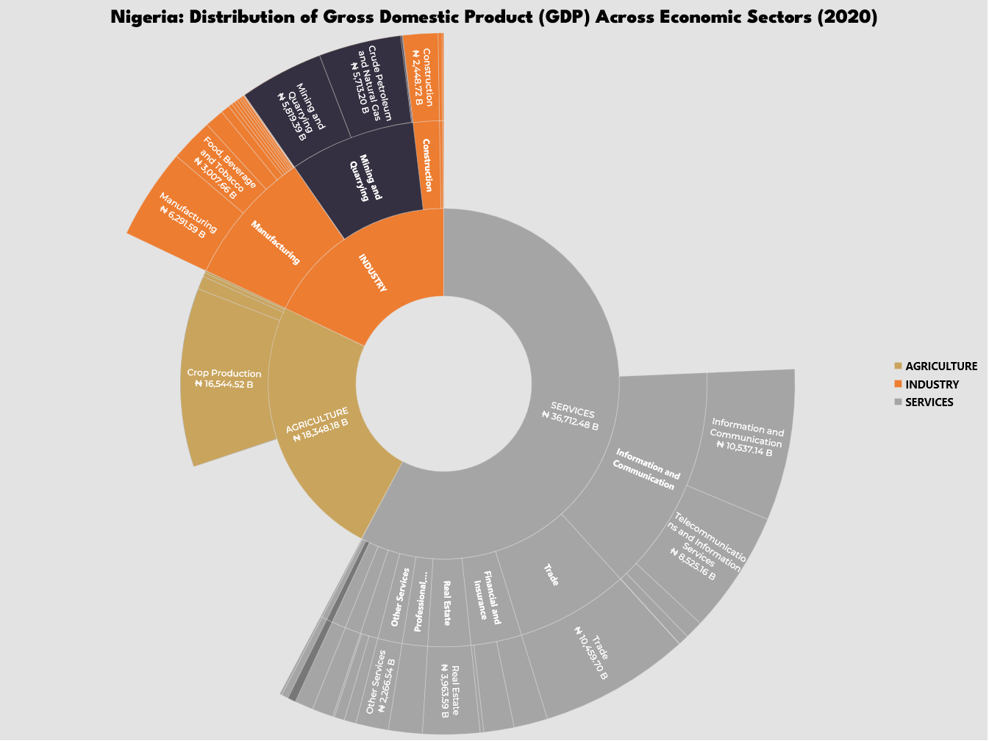
*Values in ₦ Billion
Total GDP
₦70,014.37 B
Data Source: Central Bank of Nigeria
Viz by: Daniel Bamidele

